Slide 1
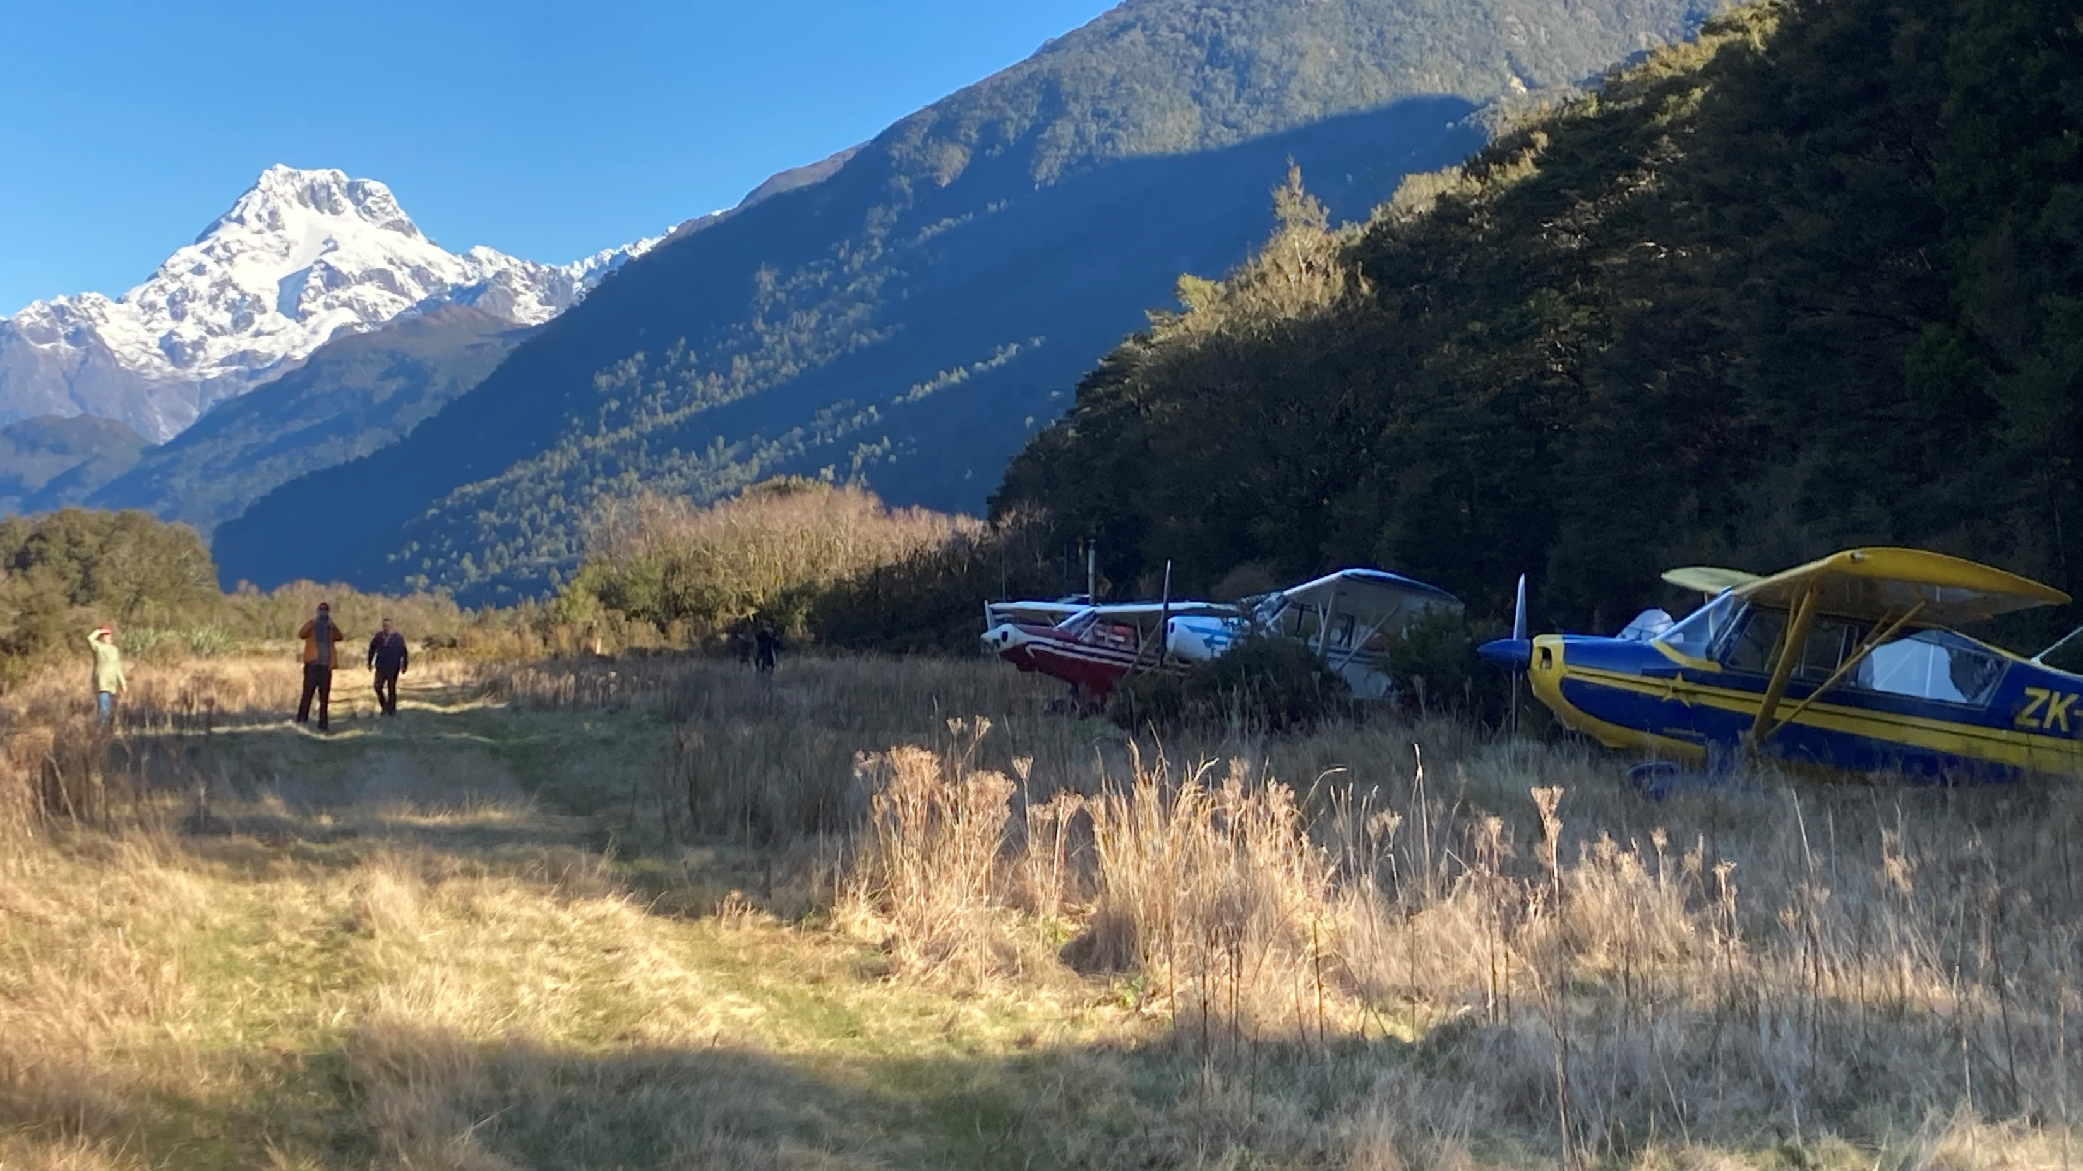
Landing accidents workshop
2022 Flight instructor seminars

Slide 2
Observations/experiences
Instructor renewals
Climate
Landing occurrences
Excursion occurrences
Identify root cause
Recommended remedial
Training/BFR/OCA

Slide 3
Instructor renewals
Instructional technique
Objectives/lesson/debrief
Decision making
Reflecting experience

Slide 4
Covid hangover/depression/complacency…
Pilot is sitting in pilot in command seat
Aircraft is ahead
Pilot should be ahead!!!

Slide 5
NOTAM related events
2019 total 24, aerodrome 10
2020 total 19, aerodrome 15
2021 total 20, aerodrome 15
2022 total 17, aerodrome 12

Slide 6
Landing accidents
Classified as such, not just excursions
Jan 22 – May 22
16 so far not including excursions to come
Resulted in red Safety Notice
Identify root cause
Identify recommended remedial

Slide 7
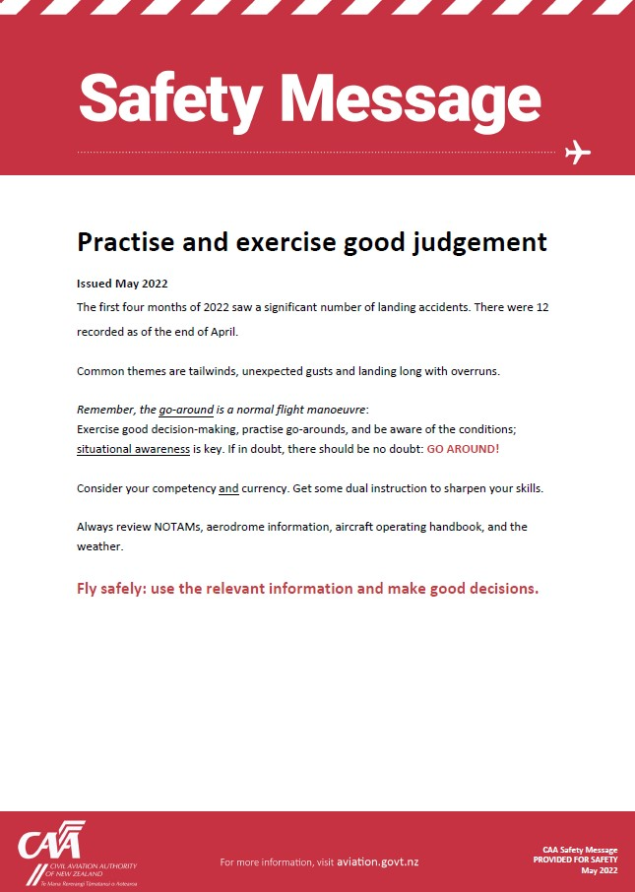

Slide 8
Excursions data
Jan 2019 – end of June 2022
Total of 59
Identify Root Cause
Recommended remedial
Outcome – list of focus training/checking points
Apply to training/BFR/OCA

Slide 9
Sector | 2019 | 2020 | 2021 | 2022 | Total
Agricultural Aviation |  |  | 1 | 3 | 4
Commercial Non Passenger |  | 11 | 7 |  | 30
Commercial Passenger Transport | 4 |  |  |  | 4
No Sector |  | 1 | 1 |  | 2
Private | 9 | 4 | 5 | 1 | 19
Total | 25 | 16 | 14 | 4 | 59

Slide 10
A/c Type | 2019 | 2020 | 2021 | 2022 | Total
Aeroplane | 22 | 12 | 10 | 3 | 47
Amateur Built Aeroplane |  | 1 | 1 |  | 2
Glider | 1 |  |  |  | 1
Microlight | 2 | 1 | 2 | 1 | 6
Not Specified |  | 1 | 1 |  | 2
Power Glider |  | 1 |  |  | 1
Total | 25 | 16 | 14 | 4 | 59

Slide 11
Nature of Flight | 2019 | 2020 | 2021 | 2022 | Total
AGRICULTURAL |  |  |  | 3 | 3
FERRY/POSITIONING |  |  | 1 |  | 1
FREIGHT ONLY | 1 |  |  |  | 1
PRIVATE OTHER | 8 | 5 | 8 | 1 | 22
Survey/inspection | 1 |  |  |  | 1
TRAINING DUAL | 6 | 1 |  |  | 7
TRAINING SOLO | 7 | 10 | 5 |  | 22
TRANSPORT PASSENGER A TO A | 1 |  |  |  | 1
TRANSPORT PASSENGER A TO B | 1 |  |  |  | 1
Total | 25 | 16 | 14 | 4 | 59

Slide 12
Phase of Flight | 2019 | 2020 | 2021 | 2022 | Total
LANDING | 20 | 14 | 12 | 4 | 50
TAKEOFF | 5 | 2 | 2 |  | 9
Total | 25 | 16 | 14 | 4 | 59

Slide 13
1 Landing accident. Following dual circuits the student sent to carry out three solo circuits. The first two were fine however on the third landed heavily and bounced twice, on the second bounce full power applied for a go-around however the aircraft quickly pitched nose up, dropped the port wing and contacted the runway heavily. Damage to undercarriage and propeller, nil injuries.
2 Precautionary landing accident. During outlanding due loss of lift, the glider positioned to a maize field close to SH2. The maize crop was approx 8ft high, as the glider descended into the tops of the maize it decelerated quickly, stalled and spun into the ground. Damage to wing, nose and canopy. Nil injuries.
3 Ground loop during touch/go for type rating. Rang PIC - a/c able to be taxied back to hangar. Undercarriage slightly bent, tailwheel bent, minor damage to rear of wingtip. No injuries.
4 A/c floated in flare and came down heavily on nosewheel. Lost directional control but managed to stop before exiting runway.
5 Landing accident. A BFR flight, after rolling out from the third landing at approx 30kts a wheel came off causing the Gyrocopter to roll over. The student and instructor vacated the aircraft, no injuries, fire then destroyed the aircraft.

Slide 14
6 Ran out of runway on landing and hit the fence due to a wind change at the airfield
7 Landing accident. The pilot made an error and landed off to the side of the strip and struck a water trough which apparently was obscured by long grass, thought he was landing in the wheel tracks from the previous day. Nose landing gear folded back with the propeller striking the strips surface. Damage to aircraft, no injuries. The pilot departed just after MCT for a short ferry flight to a local farm airstrip. The environment was still very dark due to cloudy conditions as the aircraft flew around and surveyed the area. The pilot identified what he thought were wheel marks from the previous day and lined up on them. Unfortunately, the marks were not wheel marks and soon after landing the aircraft collided with a fence line which sheared off the left outer wing before the aircraft slew around and came to a stop. Major damage was caused to the aircraft but neither occupant was injured. The Operators investigation concluded that the 'inexperienced pilot's decision to depart immediately after MCT on an overcast dark morning, while legal, was not the best decision given the prevailing dark lighting conditions.

Slide 15
8 Landing accident. Pilot reported that while landing at a private airstrip, the aircraft nosed over onto its back. Pilot thinks he possibly had his toes on the brakes causing the aircraft to nose over. Damage to aircraft, no injuries.
9 Hard landing accident. Aircraft touched down short, bounced and became airborne with a loss of directional control due low airspeed, drifted to the side of the airstrip where it bounced again lower over the edge of the strip and came to rest. The aircraft was able to be taxied using normal taxi power to the top of the strip and shutdown. Damage to aircraft, no injuries.
10 Initial notification from district council - a/c caught by wind gust and dropped 5 ft onto runway, breaking undercarriage leg and exiting runway into a fence. Fire service attended, pilot exited a/c unharmed.
11 After a normal touchdown, A/C became airborne after initial ground roll (not direct bounce), leading to a pitch down and heavy contact with the ground on the nose wheel. Damaged nose wheel subsequently departed the airframe. The A/C settled onto its nose and suffered multiple prop strikes and damage to the engine cowling and nose landing gear strut. A/C was made safe by the pilot. No injuries occurred to the sole occupant of the a/c.

Slide 16
12 Landing accident.Loss of directional control. Upon landing due to tail swing full right rudder and brake applied, the brake has engaged with the handbrake linkchain causing the right brake to lock on. This caused the right wheel to lock, the aircraft has then slewed hard to the right and nosed over with a prop strke. Damage to aircraft, no injuries.
13 Landing accident. Pilot lost directional control landing on Grass RWY, one wheel dug in and the aircraft flipped over. Damage to aircraft, minor injury.
14 During pilot's second landing during their first solo, the aircraft landed heavily on the nose wheel which then broke off. Aircraft slid to a stop nose down on the runway. No injuries.
15 Landing accident. Pilot reported that while landing, he lost directional control resulting in a ground loop. Left-hand main wheel detached, and wing tip touched the ground. Nil injuries, minor damage.
16 Landing accident. Strip landing practice, on final landing applied brakes to hard and flipped the aircraft. Nil Injuries, damage to aircraft.

Slide 17
01/01/2019 - 01/07/2022 - Occurrences where the effect on flight was recorded as Runway Excursion or Landing Overrun. Parachute and Hang-Glider occurrences have been removed. Landing undershoots or landing beside the runway/on the wrong runway are not included.

Slide 18
1 Departing, the aircraft sustained damage to RH Aileron & RH Elevator and possibly the RH main gear. Pilot reported aircraft had windshear on take-off. Aircraft completed two low passes south then north to confirm damage and security of the main gear. The aircraft collided with a runway threshold marker board and several fence posts during the take-off run. The aircraft remained airborne and slowly climbed away. The pilot declared an emergency soon after and diverted to another airfield where emergency services were available. It landed safely and there were no injuries. The aircraft received substantial damage and was removed from service for major repairs. The operator's internal investigation suggests the pilot did not correctly use the maximum performance take-off technique as described in the aircraft's flight manual. The operator has since identified and made numerous changes to its operational procedures to mitigate the possibility of any re-occurrence.

Slide 19
2 During flapless landing, a/c landed half the distance down the runway, and overran by approx 2 meters. A/c turned around and taxiied backDuring a flapless landing, the aircraft landed half the distance down the runway, and overran it by approx. 2 meters. A subsequent safety investigation identified that the pilot was somewhat complacent due to over-confidence. Currency on type could have also been a contributing factor, as this was the pilot's third flight after a few months off. The pilot was counselled on the following: Operational pressures, currency and experience on type, aircraft performance planning and decision making. The importance of the go-around was emphasised.

Slide 20
3 Loss of directional control on landing, resulting in a ground loop. No damage.
4 Runway excursion. Latter stage of landing roll, aircraft drifted off the seal into the grass with the RH wing under-surface contacting a fence batten.
5 Runway excursion during landing roll out.

Slide 21
6 Runway excursion upon landing. Aircraft touched down at the end and then veered to port with the port wheel leaving the seal and running onto the grass on the northern side of the runway, continued with the port wheel on the grass for approx. 80 metres. The aircraft initially bounced and during the recovery of the bounce, the aircraft drifted to the left and landed with the left wheel off the side of Runway. The aircraft continued for 207 metres with the left wheel off the runway. On landing, the aircraft bounced. While attempting to correct the bounce, drifted to the left. No damage was evident. …had reported a cross-wind at the time of the occurrence. Based on the Metservice weather data, the variable wind direction and gusts of up to 17 knots meant there could have been cross-winds that were at or near the limits for the aircraft at the time of landing.

Slide 22
7 During T/O drifted to the left and rolled onto the grass. Pilot continued with T/O. During next landing pilot initiated a go around due to a hard landing.
8 Runway excursion. Touched down on runway and was observed to veer sharp right off the runway. The student pilot was completing a solo cross country flight when on touch town the aircraft started veering to the right of the runway and came to a stop on the grass. The student pilot reported that they were using the crosswind landing technique but could not recall if they used the rudder to align the aircraft with the runway before touching down. The aircraft came to a stop on the side of the runway. There was no damage to the aircraft. The student pilot received remedial dual circuit training on the next lesson.

Slide 23
9 Runway excursion due to a flat tyre on landing. Tyre changed.
10 Minor take-off accident. Pilot lost directional control on take-off after the application of full power. Aircraft departed the runway to the left and came to rest in a ditch. No injuries, aircraft damaged.
11 Minor landing accident. On landing the pilot did not realise that the grass strip was wet. Left the braking to late and went through the fence at the end of the strip. No injuries.
12 Floated before touching down and continued until 1m past the end marker boards before stopping.
13 Loss of directional control on landing, aircraft came to a stop on the runway edge.

Slide 24
14 Aircraft was not going to be able to stop within the remaining distance and pilot elected to deviate to the left hand side grass verge, where nose wheel sank into mud and aircraft tipped forward striking propeller avoiding the fence.
15 A/c attempted to land which had a NOTAM in place closing the aerodrome.
16 During a touch & go, student aborted T/O without enough room to stop safely. A/c went through fence at the end of RWY, causing minor skin damage to a/c
17 During T/O instructor simulated engine failure for student. A/c skidded to the left of RWY and turned through 100 degrees to the left. The instructor gave the student a simulated engine failure during the take-off roll. The student misinterpreted the information and applied the wrong recovery actions. The aircraft departed the runway onto the grass and came to a stop before the instructor could resume control. Damage was relatively minor however numerous component were replaced on the right engine and the right main landing gear. 18 A/c left runway due unable to control a gust of wind. No damage done.

Slide 25
19 Minor landing incident. When landing in Gusty wind conditions, directional control was lost for a short while and the left wing tip and aileron touched the RWY. Control regained, came to a stop on the Grass area…. was taxied back and shut down. Left Wing tip and outer part of left aileron got minor scrape damage.
20 Runway excursion. Landed on RWY due weather with a tailwind, due to insufficient braking over ran the sealed runway onto the grass, turned back onto the seal and taxied to the terminal.. The Pilot in Command (PIC) was conducting a tailwind approach and landing due to weather conditions at the time. The tailwind was approximately 10 knots at the time of landing. The aircraft overran the seal portion of the runway, onto the grass area off the end of the seal runway. The aircraft executed a turn on the grass area and taxied to the apron without further incident. No damage was sustained. The investigation identified four factors that contributed to the PIC's choice to land with a tailwind, and the subsequent runway excursion: 1. The PIC identified that there was cloud in the valley at the end of runway at the time of the occurrence flight. The PIC elected to conduct a tailwind approach which had an approach path clear of cloud. The PIC was aware that the PIC of an earlier flight in the day landed on with an approximate 10 knot tail wind due to cloud in the valley . 2. The PIC did not fully account for the weight and speed of the aircraft with a tail wind when applying less brake. 3. The PIC was aware of recent flat and bald tyre events and elected to use less brake than they normally would in an effort to preserve brakes and tyres. 4. When the PIC realised they had not braked sufficiently, there was not enough seal to bring the aircraft to a stop without causing damage to tyres. As there were no passengers on board, the PIC chose to overrun the sealed strip onto the grass and conservatively turn there, rather than apply heavy braking. The investigation noted that after some recent flat tyres and bald patches occurring on tyres, a reminder notice to pilots was issued on the use of brakes and rudder pedals. Discussion focus of this message was to remind pilots not to 'ride the brakes', as this had been a habit.

Slide 26
21 Minor landing accident. Pilot reported landing with a tailwind and realised were going to run off the strip. Rather than risk a go-around and possibly strike trees, made decision for a low speed over-run into bush. No injuries, damage to aircraft.
22 Minor landing accident, struck a fence on the landing roll. No injuries, damage to propeller and engine frame.Prop requires replacement, engine frame repairs, engine gearbox inspection required.
23 On landing, pilot braked hard resulting in tyre locking up and bursting. A/c veered left and ran approx 5 inches into the grass off southern side of RWY.
24 Minor glider out landing accident. Overran selected paddock into a ditch, no injuries, damage to glider.
25 After landing, student tried to exit RWY at taxiway, however they were too fast and went on the grass next to the RWY
26 Student failed to stop on sealed runway and over-ran at slow speed onto the grass.
27 …landed long and came off the end of the RWY by about 10 meters
28 Runway excursion. After landing the aircraft was observed to swerve and leave the sealed runway onto the grass to the right, regained control and taxied back onto the runway.

Slide 27
29 Landed long. Touched down midway coming to a stop at the runway end marker boards.The pilot had difficulties with local turbulent conditions, remaining clear of the CTR and locating the aerodrome. The pilot was also concerned about the proximity of terrain in the late downwind position. Consequently, the aircraft flew a tight circuit and was high on finals, such that it did not land until halfway along the runway. The pilot managed to stop the aircraft at (or just beyond) the runway end marker boards. The pilot was de-briefed both locally by a CFI and by phone before continuing the return flight. The pilot has since conducted additional dual cross-country training and received further briefings on decision making with further emphasis on go-arounds and the of the arrival procedure for...
30 Aircraft was observed to land long on RWY and continued past the end of the runway marker boards and into a vacant grass area before coming to a stop
31 Landed on sealed RWY and stopped on grass overrun. The flap was not fully extending due to valve failure resulting in faster landing speed .Slight tail wind and downhill runway. Towed to hangar. No damage to aircraft.

Slide 28
32 Runway excursion. Was attempting short field landings, landed on grass just before the runway.
33 Runway Excursion. Student landed long and entered the grass area at the end of the sealed runway by approx 8-10 metres. Taxied clear.
34 Landing incident, lost directional control due to wind shift, veered off runway with the prop contacting the boundary fence.
35 Runway Excursion. veered off the runway after landing on runway ending on the grass east of the runway. Surface wind was a gusty variable easterly.
36 Landing accident. Lost directional control in a light quartering tail/crosswind, veered off the vector into knee high grass causing a slow speed tip over. No injuries, minor damage.
37 Landing accident. Student pilot on x-wind solo consolidation, during landing flare lost directional control, veered left impacting marker board, crossed RWY grass. No injuries, damage to aircraft. Landing accident.No injuries, damage to the aircraft. There was a light crosswind component of about 4-5kts at the time of the accident.
vacated the sealed section of RWY onto the grass shoulder during a touch and go landing. The pilot stopped mid field on the grass just off the sealed RWY after aborting the take off roll from the touch and go after having directional control issues

Slide 29
38 vacated the sealed section of RWY onto the grass shoulder during a touch and go landing. The pilot stopped mid field on the grass just off the sealed RWY after aborting the take off roll from the touch and go after having directional control issues
39 Directional control lost just after touchdown, resulting in a swing away from the main runway that could not be arrested before impacting a fence running close to the eastern edge of the runway. At approximately 15kts the left wing leading edge struck a fencepost, also pitching the nose forward resulting in a prop-strike with the soft ground whilst at idle power. Both occupants disembarked safely with no injuries.
40 Motor GliderTake-off Accident. During take-off roll wing tip got caught in long grass causing loss of directional control. The glider then impacted the boundary fence. Minor injuries to the pilot, nil to the pax, damage to the glider.
41 …was observed visually by the Aerodrome Controller to land to the right side of the marker cones defining the runway edge.
42 Runway excursion. Pilot over corrected on touchdown resulting in loss of directional control, the aircraft departed the runway left on to the southern grass runway. Damage to two runway end marker lights.
43 Landing accident. Touched down long on wet grass resulting in a ground loop and over-run finishing in wire boundary fence. Damage to engine and cowlings. No injuries.
44 A/c too high on approach, landed over halfway down the runway and overp-ran runway into the grass end by about a meter.
45 Runway Excursion. ..was departing RWY on their first solo circuit. …left the runway to the left/east on departure, entering the grass area but remaining upright, re-entered the RWY and proceeded to roll.

Slide 30
46 Floated long and touched down late. Applied hard braking, skidded and slightly overran of the runaway. Took a picture of wheel and contacted my instructor. Was told to just fly back from … since the wheel is not deflated and should be fine to land in … Landed fine, parked the plane and went to tell the on-duty instructor about the incident.The pilot initially made an approach for runway … however carried out a go-around due to turbulence and repositioned for … instead. However, the pilot then turned base leg too soon and was too high. therefore made a series of 's' turns to lose height. This resulted in the aircraft landing late and necessitating heavy braking. The aircraft skidded and overran of the runway slightly. The pilot was debriefed by training organisation regarding what was trained to do versus what elected to do on the day. There was possibly an element of rushing things to get out of the turbulence sooner.
47 Engine failure at 200ft AGL, carried out forced landing back onto the runway, touched down on airfield near boundary fence, bounced, contacted fence, bounced off the road and stopped by a farm fence. Damage to aircraft, no injuries.Suspected fuel pump failure.
48 Runway excursion. Fast over the fence, floated and touched down long on wet grass. Braking action poor, the aircraft slid 90 degrees into a temporary wire fence at the end of the runway. No damage.

Slide 31
49 Landing Accident. First attempt to land the pilot carried out a go-around, landed off the second approach, applying brakes the aircraft skidded on the wet grass and went through the fence at the end of the runway. No injuries, damage to aircraft.On landing the aircraft slid on damp grass and came to a halt with the port wing through the end fence at the corner of the airfield (off the centreline). Approach was normal, aircraft floated for a bit between the flare and touchdown point, but by then the PIC was committed to landing as a go around was not possible by the end of teh float. The pilot acknowledged that they need to be more respectful of wet grass and that an early go-around decision point may have helped.
50 Emergency Operations, Runway Excursion on Take-Off. Was cleared for take off on Grass, began their take off roll and then called "Mayday aborting take off". …overran TWY , went through the grass protection area and ended up on RWY … Advised they were ok and taxied back to the aero club.
51 Veered left off runway, eventually spinning 180 degrees. Left tyre found deflated and off the rim.
52 Aircraft landed on grass area to the left of grass runway. Pilot debriefed by Airways over phone.

Slide 32
53 Heavy Landing. Short final experienced sink resulting in a heavy landing. Due to the long grass created diffircult rudder control, the aircraft slid up against a 2 wire electirc fence. Aircraft assessed for damage and cleared to fly to … where further inspection carried out.
54 After touchdown, brake power was insufficient to stop before the end of the runway. The aircraft sustained minor damage after going off the end of the runway. The brakes failed a pre-flight check and so were adjusted. This adjustment was not accounted for in the control system, leading to overload of the brake actuator. The overloaded actuator failed and so braking power was severely reduced on landing. The brake system calibration procedures will be better documented in order to ensure tuning is correct. The brakes will also get further upgrades to reduce actuator loads and hence reduce the probability of failure.
55 Bird strike on landing roll. Hit LH main landing gear. Aircraft veered left on the runway. Pilot corrected but ran over the end of the runway by approximately 30ft. Tower advised pilot of bird strike. Pilot did not see the bird at the time of the event.
56 Brake failure and unable to stop on formed airstrip. 6th landing of the day - R/H brake failure. Hydraulic oil on cockpit floor.R/H brake system low in fluid due leaking fitting in park valve. Valve assy rplaced and aircraft returned to service.

Slide 33
57 Ran out of runway on landing and hit the fence due to a wind change at the airfield
58 Landing accident. The pilot made an error and landed off to the side of the strip and struck a water trough which apparently was obscured by long grass, thought he was landing in the wheel tracks from the previous day. Nose landing gear folded back with the propeller striking the strips surface. Damage to aircraft, no injuries.The pilot departed just after MCT for a short ferry flight to a local farm airstrip. The environment was still very dark due to cloudy conditions as the aircraft flew around and surveyed the area. The pilot identified what he thought were wheel marks from the previous day and lined up on them. Unfortunately, the marks were not wheel marks and soon after landing the aircraft collided with a fence line which sheared off the left outer wing before the aircraft slew around and came to a stop. Major damage was caused to the aircraft but neither occupant was injured. The Operators investigation concluded that the 'inexperienced pilot's decision to depart immediately after MCT on an overcast dark morning, while legal, was not the best decision given the prevailing dark lighting conditions.
59 Hard landing accident. Aircraft touched down short, bounced and became airborne with a loss of directional control due low airspeed, drifted to the side of the airstrip where it bounced again lower over the edge of the strip and came to rest. The aircraft was able to be taxied using normal taxi power to the top of the strip and shutdown. Damage to aircraft, no injuries.

Slide 34
Runway excursions
Complacency
Threats
Not ahead of aircraft
Tail winds
Unexpected gusts
Overruns
Closed runways

Slide 35
Landing summary
Planning decisions
Aim/touch down point
Stabilised approach
Anticipate/assess threats – before & throughout
Go around
Flare onto main gear
Keep straight
Braking only as/if required – land first

Slide 36
To conclude – Training/BFR/OCA
Focus
Training – meet syllabus/standards
BFR/OCA - What flying are they doing
Circuits a priority?
Risk based, intelligence based
NOTAM – closed runways etc

Slide 37
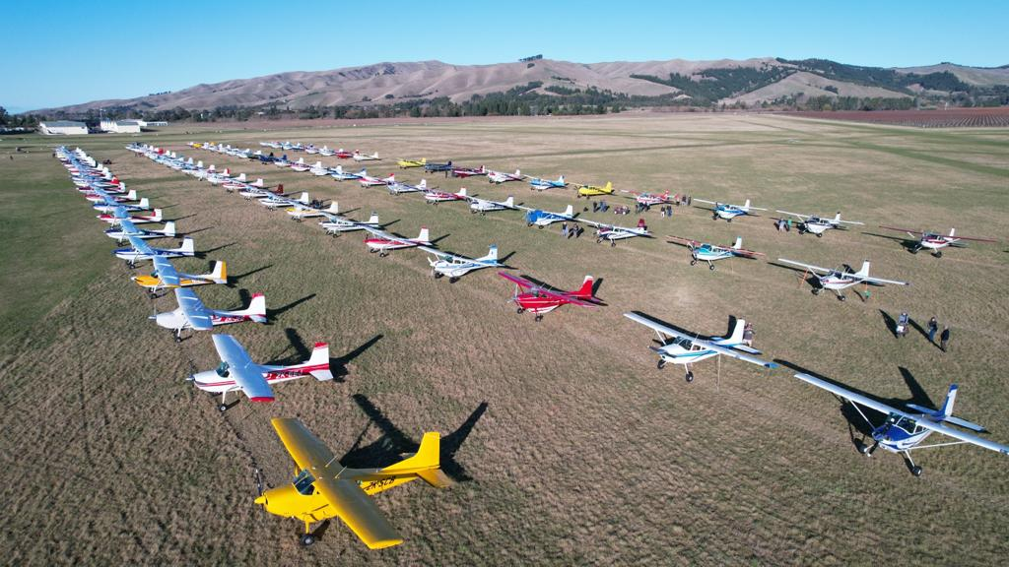
Safe flying

Slide 38
Joining
& departing threats
Joining o/h centre?
Anticipating RH?

Slide 39
